Slide 1
MEMORY MANAGEMENT
Memory management is a form of resource management applied to computer memory.
The essential requirement of memory management is to provide ways to dynamically allocate portions of memory to programs at their request, and free it for reuse when no longer needed.

Slide 2
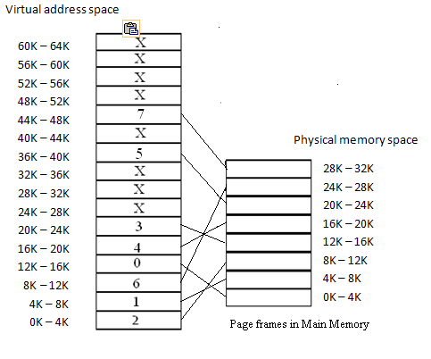
VIRTUAL ADDRESS SPACE
Address generated by CPU while a program is running is referred as Logical Address.
The logical address is virtual as it does not exist physically.
The set of all virtual addresses generated by a programs perspective is called Virtual Address Space.

Slide 3
PHYSICAL ADDRESS SPACE
Physical Address identifies a physical location in a memory.
The logical address is mapped to the physical address using a hardware called Memory-Management Unit.
The set of all physical addresses corresponding to the logical addresses in a Logical address space is called Physical Address Space.

Slide 4
Working Set, Page State
The Working set: model states that a process can be in main memory, if all of the pages that it is currently using can be in main memory.
Page State: The pages of a process's virtual address space can be in one of the following states.
Free
Reserved
Committed

Slide 5
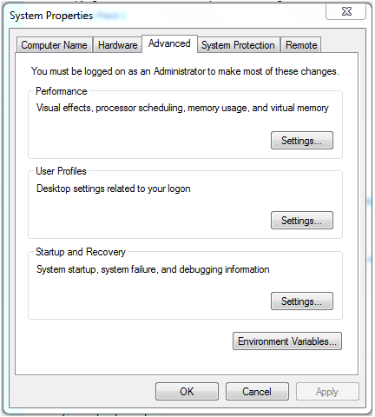
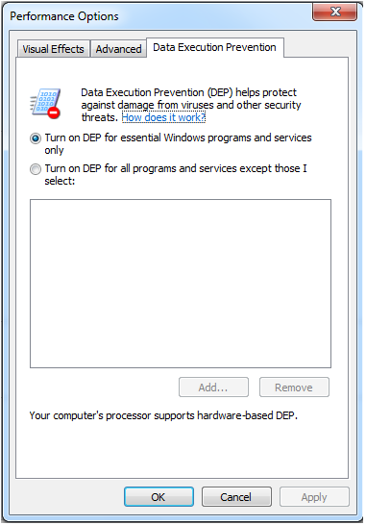
Data Execution Prevention

Slide 6
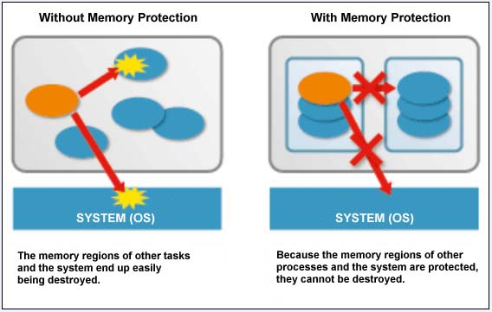
MEMORY PROTECTION
To prevent a process from accessing memory that has not been allocated to it.
This prevents a bug or malware within a process from affecting other processes, or the operating system itself.

Slide 7
PAGING
Paging is a memory management technique in which Secondary Memory space is broken into blocks of the same size called pages.
Similarly, main memory is divided into small fixed-sized blocks of (physical) memory called frames

Slide 8
When a process is to be executed, its corresponding pages are loaded into any available memory frames.
Suppose you have a program of 8kb but your memory can accommodate only 5kb at a given point in time, then the paging concept will come into picture.
When a computer runs out of ram, the operating system (os) will move idle or unwanted pages of memory to secondary memory to free up ram for other processes and brings them back when needed by the program.
This process continues during the whole execution of the program where the os keeps removing idle pages from the main memory and write them onto the secondary memory and bring them back when required by the program.

Slide 9
Main Memory
Frame 1
Frame 2
Frame 3
Frame n
Secondary Memory
Page 1
Page 3
Page 2
Page n
P | d
f | d
CPU
Page no | Frame no
P1 | F1
P2 | F2
P3 | F3
P4 | F4
Pn | Fn

Slide 10
PAGE FAULT
An interrupt that occurs when a program requests data that is not currently in real memory.
The interrupt triggers the operating system to fetch the data from a virtual memory and load it into ram.
An invalid page fault or page fault error occurs when the operating system cannot find the data in virtual memory. This usually happens when the virtual memory area, or the table that maps virtual addresses to real addresses, becomes corrupt.

Slide 11
TYPES
Minor:
If the page is loaded in memory at the time the fault is generated, but is not marked in the memory management unit as being loaded in memory, then it is called A minor or soft page fault.
Major:
This is the mechanism used by an operating system to increase the amount of program memory available on demand. The operating system delays loading parts of the program from disk until the program attempts to use it and the page fault is generated. If the page is not loaded in memory at the time of the fault, then it is called A major or hard page fault.

Slide 12
Invalid:
If a page fault occurs for a reference to an address that is not part of the virtual address space , meaning there cannot be a page in memory corresponding to it, then it is called an invalid page fault.
Illegal accesses and invalid page faults, as invalid conditions, can result in a segmentation fault or bus error, resulting in programming termination (crash) or core dump, depending on the operating system environment. Often these problems are caused by software bugs, but hardware memory errors, such as those caused by overclocking, may corrupt pointers and make correct software fail. It can also crash the operating system.

Slide 13
THRASHING
As the working set grows, resolving page faults remains manageable until the growth reaches a critical point.
Then faults go up dramatically and the time spent resolving them overwhelms time spent on the computing the program was written to do.
Thrashing occurs on a program that works with huge data structures, as its large working set causes continual page faults that drastically slow down the system

Slide 14
MEMORY POOL
Memory pools, also called fixed-size blocks allocation, is the use of pools for memory management that allows dynamic memory allocation comparable to malloc or java’s operator new.
Types of Memory Pool
Non Paged Pool
Paged Pool

Slide 15
VIRTUAL MEMORY
The basic idea of virtual memory is to keep only those parts of the program currently in use in the memory and the rest on the disk drive.
For example: a 16m program can run on a 4m machine by carefully choosing which 4m to keep in memory at each instant, with pieces of the program being swapped between disk and memory as needed.

Slide 16
SWAPPING
The process of moving data from RAM to disk (and back) is known as swapping or paging.
The virtual memory manager (vmm) is in charge of swapping data between physical memory and the hard disk.

Slide 17
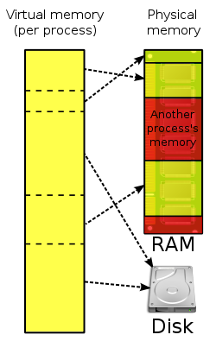
Virtual Memory implemented using PAGING

